Slide 1
Lecture 7 Describe Quantitative Data with Numbers (ctns) Identify outliers & Boxplot

Slide 2
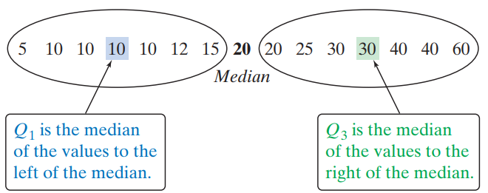

Slide 3
Travel times to work for 20 randomly selected New Yorkers
10 | 30 | 5 | 25 | 40 | 20 | 10 | 15 | 30 | 20 | 15 | 20 | 85 | 15 | 65 | 15 | 60 | 60 | 40 | 45
5 | 10 | 10 | 15 | 15 | 15 | 15 | 20 | 20 | 20 | 25 | 30 | 30 | 40 | 40 | 45 | 60 | 60 | 65 | 85
5 | 10 | 10 | 15 | 15 | 15 | 15 | 20 | 20 | 20 | 25 | 30 | 30 | 40 | 40 | 45 | 60 | 60 | 65 | 85
Q₁ = 15
M = 22.5
Q₃= 42.5
IQR = Q₃ – Q₁
= 42.5 – 15
= 27.5 minutes

Slide 4
Identifying Outliers
In addition to serving as a measure of spread, the interquartile range (IQR) is used as part of a rule of thumb for identifying outliers.
Definition:
The 1.5 x IQR Rule for Outliers
Call an observation an outlier if it falls outside the interval [Q1-1.5 x IQR , Q3+1.5 x IQR].

Slide 5
Why we use 1.5*IQR:
20% of all measurements are outside [Q1-0.5*IQR , Q3+0.5*IQR]
5% of all measurements are outside [Q1-IQR , Q3+IQR]
0.8% of all measurements are outside [Q1-1.5*IQR , Q3+1.5*IQR]
0.08% of all measurements are outside[Q1-2*IQR , Q3+2*IQR]

Slide 6
Why we use 1.5*IQR:
5% of all measurements are outside [Q1-IQR , Q3+IQR]
making too many outliers
0.8% of all measurements are outside [Q1-1.5*IQR , Q3+1.5*IQR]
0.08% of all measurements are outside[Q1-2*IQR , Q3+2*IQR]
turning many quite extreme measurements into non-outliers

Slide 7

Why we use 1.5*IQR:
5% of all measurements are outside [Q1-IQR , Q3+IQR]
making too many outliers
0.8% of all measurements are outside [Q1-1.5*IQR , Q3+1.5*IQR]
0.08% of all measurements are outside[Q1-2*IQR , Q3+2*IQR]
turning many quite extreme measurements into non-outliers

Slide 8
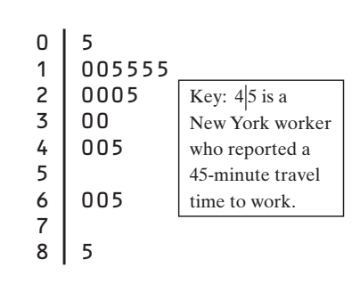
In the New York travel time data:
Q1=15 minutes
Q3=42.5 minutes
IQR=27.5 minutes
For these data, 1.5 x IQR = 41.25
Q1- 1.5 x IQR = 15 – 41.25 = -26.25
Q3+ 1.5 x IQR = 42.5 + 41.25 = 83.75
According to the 1.5 * IQR rule, any travel time shorter than -26.25 minutes or longer than 83.75 minutes is considered an outlier.

Slide 9
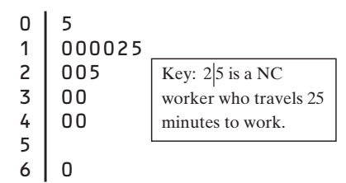
Check your understanding: Earlier, we noted the influence of one long travel time of 60 minutes in our sample of 15 North Carolina workers.
Problem: Determine whether there are outliers.

Slide 10
Check your understanding:
We found that Q1 = 10 minutes,
Q3 = 30 minutes,
and IQR = 20 minutes.
Then, we have 1.5 × IQR = 30 by the 1.5 × IQR rule, any value greater than Q3 + 1.5 × IQR = 60 or less than Q1 - 1.5 × IQR = -20 would be classified as an outlier.
The maximum value of 60 minutes is not quite large enough to be an outlier because it falls right on the upper cutoff value
EXAM TIP:
You may be asked to determine whether a quantitative data set has any outliers. Be prepared to
state the rule (according to the 1.5 × IQR rule) and
use the rule
for identifying outliers.

Slide 11
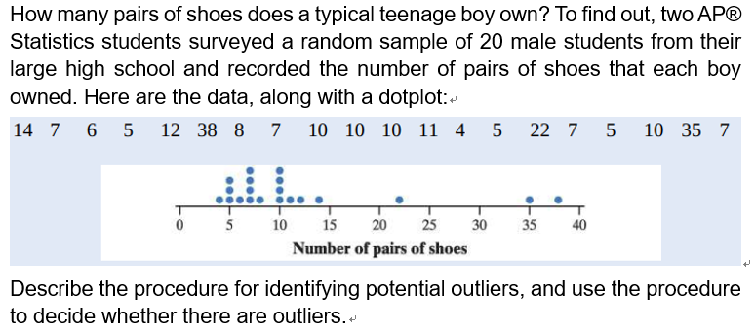
Outliers are identified as any observation outside of the interval bounded by Q1-1.5*IQR and Q3+1.5*IQR.
The IQR in this case is Q3-Q1=11.5-6.5=5 pairs and 1.5*IQR=7.5.
The interval lower bound is Q1-1.5*IQR=6.5-7.5= -1 and the upper bound is Q3+1.5*IQR = 11.5+7.5 = 19 pairs.
Since 22, 35 and 38 pairs are outside of this interval, they are outliers. No other observation is outside the interval.

Slide 12
What is the 1.5 * IQR rule?
Outliers are identified as any observation outside of the interval bounded by Q1-1.5*IQR and Q3+1.5*IQR.
Calculate the IQR and the interval
The IQR in this case is Q3-Q1=11.5-6.5=5 pairs.
The interval lower bound is Q1-1.5*IQR=6.5-5=1.5 pairs and the upper bound is Q3+1.5*IQR = 1.5+5 = 16.5 pairs.
Context
Since 22, 35 and 38 pairs are outside of this interval, they are outliers. No other observation is outside the interval.

Slide 13
The Five-Number Summary
minimum and maximum values: distribution as a whole
median and quartiles: tails of a distribution
To get a quick summary of both center and spread, combine all five numbers: Min, Q1, Q2 (median), Q3,Max.

Slide 14
Definition:
The five-number summary of a distribution consists of the smallest observation, the first quartile, the median, the third quartile, and the largest observation, written in order from smallest to largest.
Minimum Q₁ M Q₃ Maximum

Slide 15
Boxplots (Box-and-Whisker Plots)
The five-number summary divides the distribution roughly into quarters. This leads to a new way to display quantitative data, the boxplot.
How To Make A Boxplot:
Calculate Q1,Q2,Q3 and IQR and identify whether there are outliers.
A central box is drawn from the first quartile (Q₁) to the third quartile (Q₃).
A line in the box marks the median.
Lines (called whiskers) extend from the box out to the smallest and largest observations that are not outliers.

Slide 16

Boxplots (Box-and-Whisker Plots)
The five-number summary divides the distribution roughly into quarters. This leads to a new way to display quantitative data, the boxplot.
How To Make A Boxplot:
Calculate Q1,Q2,Q3 and IQR and identify whether there are outliers.
A central box is drawn from the first quartile (Q₁) to the third quartile (Q₃).
A line in the box marks the median.
Lines (called whiskers) extend from the box out to the smallest and largest observations that are not outliers.

Slide 17
Boxplots (Box-and-Whisker Plots)
The five-number summary divides the distribution roughly into quarters. This leads to a new way to display quantitative data, the boxplot.
How To Make A Boxplot:
Final step: mark all the outlier(s)
Outliers are marked with a special symbol such as an asterisk (*) or a dark dot.

Slide 18
Example
Barry Bonds set the major league record by hitting 73 home runs in a single season in 2001. On August 7, 2007, Bonds hit his 756th career home run, which broke Hank Aaron’s longstanding record of 755. By the end of the 2007 season when Bonds retired, he had increased the total to 762. Here are data on the number of home runs that Bonds hit in each of his 21 complete seasons: 16 25 24 19 33 25 34 46 37 33 42 40 37 34 49 73 46 45 45 26 28
Problem: Make a boxplot for these data

Slide 19
16 25 24 19 33 25 34 46 37 33 42 40 37 34 49 73 46 45 45 26 28
Problem: Make a boxplot for these data
Find the five-number summary ( by ordering the data values )
2. Check for outliers.
Since IQR = 45 - 25.5 = 19.5, by the 1.5 × IQR rule, any value greater than Q3 + 1.5 × IQR = 74.25 or less than Q1 - 1.5 × IQR = -3.75 would be classified as an outlier.
So there are no outliers in this data set.
3. Make a boxplot !

Slide 20
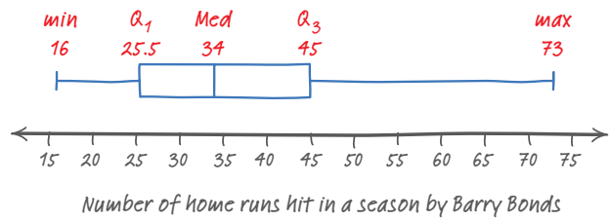
Min = 16 Q1 = 25.5 Median = 34 Q3 = 45 Max = 73
A central box is drawn from the first quartile (Q₁) to the third quartile (Q₃).
A line in the box marks the median.
Lines (called whiskers) extend from the box out to the smallest and largest observations that are not outliers.
Outliers are marked with a special symbol such as an asterisk (*).

Slide 21
Check your understanding

Slide 22
Consider our New York travel time data:
10 | 30 | 5 | 25 | 40 | 20 | 10 | 15 | 30 | 20 | 15 | 20 | 85 | 15 | 65 | 15 | 60 | 60 | 40 | 45
5 | 10 | 10 | 15 | 15 | 15 | 15 | 20 | 20 | 20 | 25 | 30 | 30 | 40 | 40 | 45 | 60 | 60 | 65 | 85
Min=5
Q₁ = 15
Median = 22.5
Q₃= 42.5
Max=85
Recall, this is an outlier by the
1.5 x IQR rule

Slide 23
Good Job！！

Slide 24
Identifying Outliers
In addition to serving as a measure of spread, the interquartile range (IQR) is used as part of a rule of thumb for identifying outliers.
Definition:
The 1.5 x IQR Rule for Outliers
Call an observation an outlier if it falls more than 1.5 x IQR
above the third quartile or
below the first quartile.
Notes:
我们来看一下怎么用IQR来找outliers
之前我们只能看有没有gap，以后我们就可以用IQR来给出精准的判断了

Slide 25
In the New York travel time data:
Q1=15 minutes
Q3=42.5 minutes
IQR=27.5 minutes
For these data, 1.5 x IQR = 41.25
Q1- 1.5 x IQR = 15 – 41.25 = -26.25
Q3+ 1.5 x IQR = 42.5 + 41.25 = 83.75
Any travel time shorter than -26.25 minutes or longer than 83.75 minutes is considered an outlier.

Slide 26
Check your understanding: Earlier, we noted the influence of one long travel time of 60 minutes in our sample of 15 North Carolina workers.
Problem: Determine whether this value is an outlier

Slide 27
We found that Q1 = 10 minutes,
Q3 = 30 minutes,
and IQR = 20 minutes.
Then, we have 1.5 × IQR = 1.5(20) = 30
By the 1.5 × IQR rule, any value greater than Q3 + 1.5 × IQR = 30 + 30 = 60 or less than Q1 - 1.5 × IQR = 10 - 30 = -20 would be classified as an outlier.
The maximum value of 60 minutes is not quite large enough to be an outlier because it falls right on the upper cutoff value
EXAM TIP:
You may be asked to determine whether a quantitative data set has any outliers.
Be prepared to state and use the rule for identifying outliers.
Notes:
Exam tip：
不仅要指出哪个是outlier，还要给出1.5IQR是怎么用的

Slide 28
The Five-Number Summary
The minimum and maximum values tell us about the distribution as a whole.
The median and quartiles tell us about the tails of a distribution.
To get a quick summary of both center and spread,
combine all five numbers！
Notes:
那截止到现在我们学了median，min, max, Q1 and Q3，这五个值就能大概描述这组数据了，所以我们有了一个新概念，five-number summary，就是这五个特征值综合起来

Slide 29
Definition:
The five-number summary of a distribution consists of the smallest observation, the first quartile, the median, the third quartile, and the largest observation, written in order from smallest to largest.
Minimum Q₁ M Q₃ Maximum

Slide 30
Boxplots (Box-and-Whisker Plots)
The five-number summary divides the distribution roughly into quarters. This leads to a new way to display quantitative data, the boxplot.
How To Make A Boxplot:
A central box is drawn from the first quartile (Q₁) to the third quartile (Q₃).
A line in the box marks the median.
Lines (called whiskers) extend from the box out to the smallest and largest observations that are not outliers.
Outliers are marked with a special symbol such as an asterisk (*).
Notes:
用这五个值就有了新的图，叫 boxplot
一起看一下怎么画

Slide 31
Example
Barry Bonds set the major league record by hitting 73 home runs in a single season in 2001. On August 7, 2007, Bonds hit his 756th career home run, which broke Hank Aaron’s longstanding record of 755. By the end of the 2007 season when Bonds retired, he had increased the total to 762. Here are data on the number of home runs that Bonds hit in each of his 21 complete seasons: 16 25 24 19 33 25 34 46 37 33 42 40 37 34 49 73 46 45 45 26 28
Problem: Make a boxplot for these data

Slide 32
16 25 24 19 33 25 34 46 37 33 42 40 37 34 49 73 46 45 45 26 28
Problem: Make a boxplot for these data
Find the five-number summary ( by ordering the data values )
2. Check for outliers.
Since IQR = 45 - 25.5 = 19.5, by the 1.5 × IQR rule, any value greater than Q3 + 1.5 × IQR = 74.25 or less than Q1 - 1.5 × IQR = -3.75 would be classified as an outlier.
So there are no outliers in this data set.
3. Make a boxplot !
Notes:
首先要找到这五个值
找到outlier
画图

Slide 33
Min = 16 Q1 = 25.5 Median = 34 Q3 = 45 Max = 73
A central box is drawn from the first quartile (Q₁) to the third quartile (Q₃).
A line in the box marks the median.
Lines (called whiskers) extend from the box out to the smallest and largest observations that are not outliers.
Outliers are marked with a special symbol such as an asterisk (*).

Slide 34
Practice
Consider our New York travel time data:
10 | 30 | 5 | 25 | 40 | 20 | 10 | 15 | 30 | 20 | 15 | 20 | 85 | 15 | 65 | 15 | 60 | 60 | 40 | 45
5 | 10 | 10 | 15 | 15 | 15 | 15 | 20 | 20 | 20 | 25 | 30 | 30 | 40 | 40 | 45 | 60 | 60 | 65 | 85
Min=5
Q₁ = 15
Median = 22.5
Q₃= 42.5
Max=85
Recall, this is an outlier by the
1.5 x IQR rule

Slide 35

Measuring Spread: Deviation
The n deviations from the mean are the differences
$$x_{1}−\overline{x}, x_{2}−\overline{x}, …, x_{n}−\overline{x},$$
= 5
Notes:
但是如果我们想要去求 整个数据集的 波动之和的话，我们把deviations 加起来发现 等于几? 0
所以我们把deviation升级一下，还有没有其他可以描述离均值的距离的指标了？
可以取绝对值，也可以取平方。
一般来说都用平方，因为在更深的理论，要遇到求导的情况，绝对值很难求

Slide 36
Homework
P199
4.33 4.35

